Slide 1
IT Application PROJECT PROPOSAL
By Boomitha, Gavin, Darren and Rayyan

Slide 2

01.
Main Idea

Slide 3

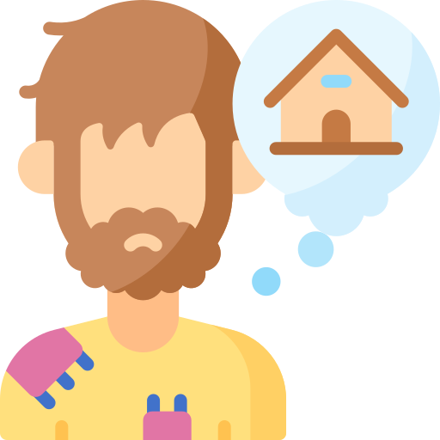
Main Idea
Game
To educate people about the struggle of homelessness

Slide 4
02.
Our Company

Slide 5

Our Company
BoomiHome

Slide 6
Our Company
Non profit organisation
International charity
Dedicated for homeless people to lead a better life
Our slogan is “Thrive to Survive”

Slide 7
03.
Purpose

Slide 8
Purpose
To help people become more empathetic to homeless people through understanding their struggles
To entice people into donating to our charity after experiencing how difficult it is to survive homelessness

Slide 9

04.
Business Needs

Slide 10

Online Fundraising platform
Business Needs
Having an online platform rather than a physical platform is better as we would have more exposure online
People from all over the world are able to donate, rather than being limited to certain countries and areas.

Slide 11

Data Analytics
Business Needs
Need real time data to better address the struggle of homelessness
Data particularly on homelessness trends, demographics and socio-economic factors
Collect, understand and analyse the information
We can work proactively towards preventing and reducing homelessness in diverse and impactful ways.

Slide 12

Volunteer Engagement
Business Needs
Engaging volunteers through gamification
Gamification is using game-like elements and principle to motivate others
Collect, understand and analyse the information
Will be including “Achievements” (milestones) both in our game and in our fundraising websites

Slide 13
05.
Details about the Game

Slide 14
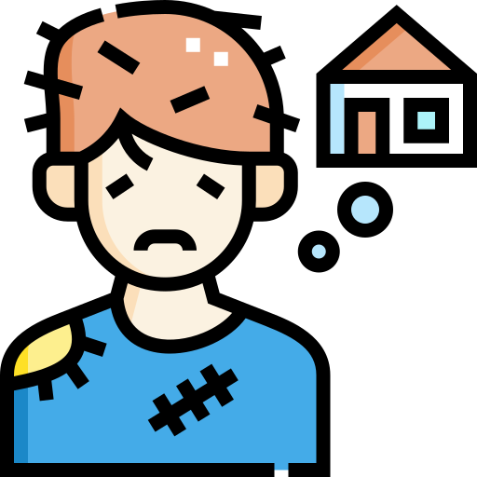
Plot of the game
Details of the Game
A character who got evicted from his home after losing his job due to missing the job quota frequently over a few months
Objective is to survive each passing day

Slide 15
Plot of the game
Details of the Game
One of the main Objectives is to try to rebuild your life from the ground up
Juggle between your needs as they become increasingly demanding over time
Over time, more events and restrictions are placed on the player until they either rebuild their life or lose

Slide 16


Genre of the Game
Details of the Game
= Point and Click

Slide 17

Action point system
Details of the Game
Every day you will have 4 “ action points”
Start off with $10 , 5 hunger and mental points
Every day that passes reduces the hunger and mental points by 1 point each.
Every 2 action points consumed also reduces hunger and mental point by 1 each

Slide 18

Action point system
Details of the Game
Available actions include “Begging” - Main method of getting cash, unreliable includes a drawback of failure costing you 1 mental point “Stroll in the Park” - Restores 2 mental points “Purchase Food” - Spend 5 dollars to buy food “Eat Food” - Restores 2 hunger points, requires food to perform action “Scavenge for Food” - Chance to obtain normal food or rotten food when eaten, it lowers mental and hunger points by 1 “Sleep” - Sleep and enter the next day, restores 1 mental point

Slide 19

Restrictions/Events
Details of the Game
There is a random chance that your current sleeping area will be embedded with anti-homeless spikes; you need to spend 1 action point to find a new sleeping area.
**If you run out of hunger, mental, or action points before sleeping, you lose the game.**

Slide 20

Progression/Achievements
Details of the Game
Survived 15 days {Moderate}
Survived 20 days {Hard}
Survived 30 days {Lunatic}
Reached 25 dollars {Easy}
Reached 50 dollars {Moderate}
Reach max hunger and mental points after having both of them at 1 simultaneously at any point in the same attempt {Lunatic}

Slide 21
Details of the Game
Side Note: This game is meant to be very difficult in order to get through to the players how tough it really is to be homeless.

Slide 22
Thanks for listening !!!

